Slide 1
Object-Oriented Languages
1. Procedural programming languages:
  Functional decomposition
  Collections of subprograms
  Fortran, COBOL, C, Pascal
Ada83
Packages, generics, and tasks provide data abstraction, information hiding.
Surprisingly, no inheritence mechanism, therefore: Object-based.
2. Object-Oriented languages:
  start with a view of the things in the domain of discourse
  may be “pure” if everything is an object (Smalltalk), or “hybrid” like C++ or Ada95.
Now: dialects of most languages support OO: COBOL97, CLOS.
“Support for multiple paradigms” – apology for being a hash or a strength of the language?
How about Java?

Slide 2
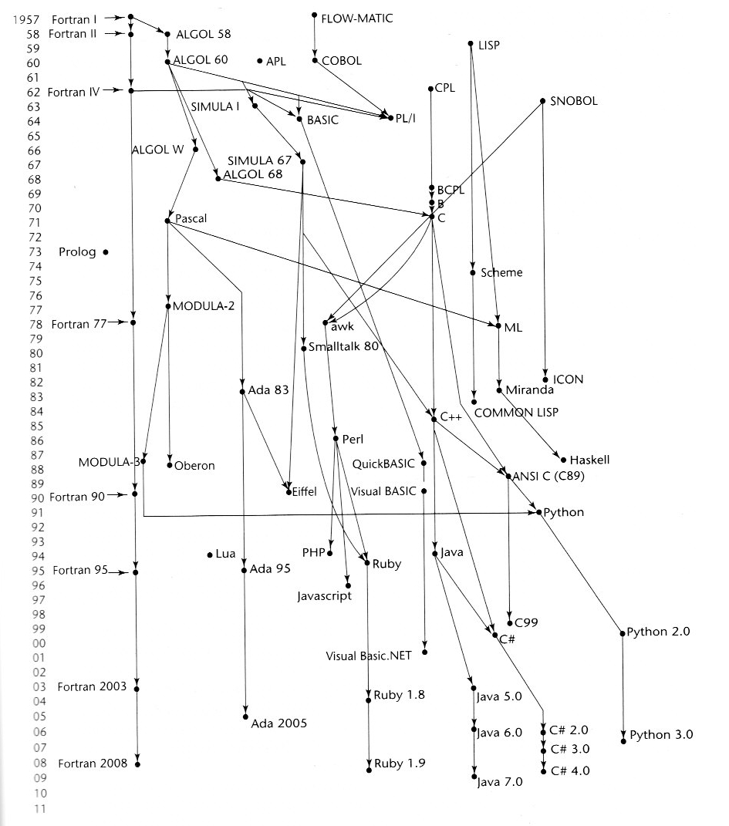

Slide 3
Abstract Data Types
Abstract Data Types form the basis of Object Oriented programming languages, design and programming.
Abstraction – a view of an entity that includes only the most significant attributes
Types of Abstraction:
  Process abstraction
  Data Abstraction
Abstract Datas types:
  The declarations of the type
  The protocols of the operations on objects of that type
Abstraction through the separation of specification from implementation:
  Ada:
    Specification part
    Implementation part
  C++
    Header
    Body
  Java?

Slide 4
An Ada Package
  generic
  type STACK_TYPE is private;
  package STACK1 is
  procedure PUSH(X: in STACK_TYPE);
  procedure POP(X: out STACK_TYPE);
  function EMPTY return BOOLEAN;
  function FULL return BOOLEAN;
  STACK_ERROR: exception;
  private
  MAX_SIZE : constant := 100;
  end STACK1;

Slide 5
package body STACK1 is
ST :array (1..MAX_SIZE) of STACK_TYPE;
TOP: INTEGER range 0..MAX_SIZE := 0;
procedure PUSH(X: in STACK_TYPE) is
begin
if FULL() then raise STACK_ERROR;
else
TOP := TOP + 1; ST(TOP) := X;
end if;
end PUSH;
procedure POP(X: out STACK_TYPE) is
begin
if EMPTY() then raise STACK_ERROR;
else
X := ST(TOP); TOP := TOP - 1;
end if;
end PUSH;
function EMPTY return BOOLEAN is
begin
return TOP = 0;
end;
function FULL return BOOLEAN is
begin
return TOP = MAX_SIZE;
end;
end STACK1;
package Stack_Int is new Generic_STACK1(STACK_TYPE => Integer);

Slide 6
A C++ Example
template< class T >
class Stack {
public:
Stack( int = 10 ); // default constructor
~Stack() { delete [] stackPtr; }
bool push( const T& ); // push an element
bool pop( T& ); // pop an element
private:
int size; // # of elements
int top; // location of top
*stackPtr; // pointer to stack
bool isEmpty() const
{ return top == -1; }
// utility
bool isFull() const
{ return top == size - 1; } // functions
};

Slide 7
template< class T >
Stack< T >::Stack( int s )
{
size = s > 0 ? s : 10;
top = -1; // Stack is initially empty
stackPtr = new T[ size ]; // allocate it
}
// Push an element onto the stack
template< class T >
bool Stack< T >::push( const T & pushValue )
{
if ( !isFull() ) {
stackPtr[ ++top ] = pushValue;
return true; // push successful
}
return false; // push unsuccessful
}
// Pop an element off the stack
template< class T >
bool Stack< T >::pop( T &popValue )
{
if ( !isEmpty() ) {
popValue = stackPtr[ top-- ];
return true; // pop successful
}
return false; // pop unsuccessful
}

Slide 8
An Objective C Example
#import <Foundation/Foundation.h>
@interface Stack: NSObject {
int StackArray[100];
int StackPtr;
int maxLen;
int top;
}
- (void) push: (int) number;
- (void) pop;
- (int) top;
- (BOOL) empty;
@end
@implementation Stack
-(Stack *) initWith{
maxLen = 100;
top = -1;
stackPtr = StackArray;
return self;
}

Slide 9
-(void) push: (int) number {
if(top == maxLen)
NSLog(@"Error in push: stack full");
else
stackPtr[++top] = number;
}
-(void) pop: {
if(top == -1)
NSLog(@"Error in pop: stack empty");
else
top--;
}
-(int) top: {
if(top >= 0)
return stackPtr[top];
else
NSLog(@"Error in top: stack empty");
}
-(BOOL) empty: {
if(top >= 0)
return top == -1;
}

Slide 10
int main(int argc char *argv[])
{
int temp;
NSAutorreleasePool *pool = [[NSAutoreleasePool
alloc] init];
Stack *myStack = [[Stack alloc]initWith];
[myStack push: 5];
[myStack push: 3];
temp = [myStack top];
NSLog(@Top element is:%i",temp);
[myStack pop];
temp = [myStack top];
NSLog(@Top element is:%i",temp);
[myStack pop];
temp = [myStack top];
[myStack pop];
[myStack release];
[pool drain];
}
NSAutorreleasePool is for Cocoa’s reference counter

Slide 11
Terms Associated with Object-Oriented Programming
Classes – abstract data types as implemented in Object-oriented programming
Objects – instances of classes
Derived Class – a subclass defined through inheritance from another class
Methods – operations associated with a class
Messages – calls to methods
Message protocol – the entire collection of methods of a class
Over-ridden methods – modification/extension of an inherited method
Class and Instance methods and variables:
  Class variable – belong to the class, not to an instance. Only one copy for the class
  Class method – associated with the class not instances
  Instance Variable – data elements associated with instances of a class
  Instance Methods – methods that act upon instances of a class
Single versus Multiple Inheritance – does a derived class have only one or more than one parent class?
Abstract Methods – methods that are associated with very general classes that are not meant to be instantiated
Abstract Classes – have at least one abstract method and is not instantiated.

Slide 12
Object Oriented Programming
Object Oriented Programming is best explained in terms of three techniques:
  Encapsulation
  Inheritance
  Polymorphism

Slide 13
Encapsulation
Encapsulation - hide away inner workings of the code and present a well-defined interface that tells the rest of the world only what it needs to know to use the object. Correlary to this idea is providing varying degrees of access to elements in the object.
Wristwatch example - Don’t care if the watch keeps time by vibrating a crystal or by a mechanism driven by a spring.
Hardware encapsulation - Buy screens, printers, and disk drives with agreed-upon interfaces. Plug them together and they work (hopefully)

Slide 14
Inheritance
Inheritance allows easy creation of objects that add details to other more general objects.
Classes are a natural building block, representing a common set of similar objects
  More specialized classes (subclasses) selectively inherit and override the attributes and the operations of the more general classes (superclasses)
  Inheritance reflects the generalization and specialization relationships between objects (subclasses are specializations of the more general superclasses)
A Java Example (JTextArea)
While we are talking Java...

Slide 15
Example
Example Inheritance Hierarchy
Graphical
Object
Polygon
Circle
Rectangle
Triangle
Square
Icosceles
Triangle

Slide 16
Class Hierarchies
Generalization, Specialization and Instantiation
Generalization
Specialization
Evolving basic
Defining classes that are similar to the
superclass, while reusing selected
attribute and operation definitions
and adding or overriding others.
classes that are
more reusable
Class Hierarchy
Instance Objects
Instantiation
Creating instances
that exhibit the
attributes and
behaviors of their
class.

Slide 17
Derived Classes
Start with a more general class.
Deriving a class means defining a new subclass of the more general class that retains some of the characteristics of the more general class but which may have different characteristics (attributes) or operations (methods)
Example:
Class = graphical object
Attributes:
  Position
  Color
Methods
  Draw
  Resize
  Move
SubClass = Circle
(a derived class of graphical object)
Attributes:
  Radius
Override
  Draw

Slide 18
Abstract Base classes and Concrete classes
The only purpose of an abstract class is to provide a base class from which derived classes can inherit interfaces or implementations.
Comparison of Abstract to concrete classes:
  Abstract – won’t be instantiated. These are base classes with inheritance
  Concrete – WILL be instantiated.
Creating Abstract Base Classses
  A class with one or more pure virtual functions will be abstract:
  virtual void draw() const = 0;

Slide 19
Example Class Hierarchy
A Class hierarchy shows the generalization, specialization relationships of a system.
  All object oriented systems have a class hierarchy
  The hierarchy is comprised of both system defined and user defined classes and objects
Object
number
displayObject
indexedCollection
rectangle pen window
scribe anotherscribe

Slide 20
Hierarchical Subclasses
In real life, the same objects can often be grouped in several ways. Hierarchical organization of subclasses precludes orthogonal classifications.
Example: computer-assisted design of a car
  Various elements have various attributes (bumpers, hubcaps, paint, washers, engine, etc.)
  The goal is to classify objects according to their common attributes
Object
number
display
Object
Inventory
Item
Indexed
Collection
rectangle pen bumper hubcap button

Slide 21
Hierarchical Subclasses
Some of these items aren’t typically seen, even though they share some attributes with others that are seen.
Some of our car example items might be found in an inventory list leading to a grouping of attributes as follows:
Object
number
display
Object
Inventory
Item
indexed
Collection
bumper hubcap paint engine washers

Slide 22
Hierarchical Subclasses
As a consequence, we must either choose displayobject to be the superclass or we must choose inventoryitem to be the superclass.
A first try:
Object
number
display
Object
indexed
Collection
rectangle pen inventoryitem button
bumper hubcap paint engine washers

Slide 23
A Second (equally unsatisfactory) Organization:
Object
number
inventoryItem
indexed
Collection
paint engine washers
display
Object
bumper hubcap rectangle pen button

Slide 24
Multiple Inheritance
The term multiple inheritance is used imprecisely to mean
  A conceptual relationship between classes
  The language mechanism that implements that relationship by sharing data and behaviors
Benefits:
  Brings object modeling closer to the way that people think
  Allows greater power in specifying classes
  Allows greater opportunities for reuse
Drawbacks
  Causes a loss of conceptual and implementation simplicity
  Requires complex mixing rules to resolve conflicts among features defined on different paths
  Conflicts among parallel definitions must be resolved in implementations
  Subclasses may be disjoint or not, further complicating the picture

Slide 25
Multiple Inheritance
Some versions of Smalltalk and version 2 of C++ support multiple inheritance:
Object
number
display
Object
indexed
Collection
Inventory
Item
rectangle pen bumper hubcap button paint engine washers
scribe anotherscribe

Slide 26
Multiple Inheritance
Multiple inheritance - Example:
class Asset. .
class InsurableItem. . .
class InterestEarning. . .
class BankAccount:public Asset,
public InsurableItem,
public InterestEarning. . .
class RealEstate :public Asset,
public InsurableItem. . .
class Security :public Asset,
public InterestEarning. . .
class SavingsAccount: public . . .
class CheckingAccount: public BankAccount
class Stock:public Security. . .
class Bond:public Security. . .

Slide 27
Multiple Inheritence Problems
Name collisions are possible - Asset and InsurableItem both have a presentValue attribute. RealEstate inherits from both, must disambiguate presentValue binding.
Strategies to resolve problem:
1. Make name collision illegal - compiler flags it (Eiffel, Smalltalk)
2. Regard as one attribute (CLOS)
3. Avoid collisions, require fully qualified references (C++)
A C++ Example

Slide 28
Repeated Inheritance
Repeated inheritance (sometimes called diamond inheritence):
class Stock:public Security;
class Bond: public Security;
class MutualFund:public Stock, public Bond. . .
Security
Stock
Bond
MutualFund

Slide 29
Java Interfaces
Java supports single inheritence.
Java supports a virtual class called an interface. An interface is like a class definition except it contains only named constants and method definitions.
Example:
Applets running an animation. The animation must run in a thread.
The derived applet Inherits from: Java.Applet
Cuncurrency is supported by deriving from Thread.
Java has a predefined interface named runnable that provides the interface but not implementation to methods in thread.
public class clock extends Applet implements Runnable

Slide 30
Interfaces
Contain:
  constants (final variables) and
  method prototypes (signatures)
Defining the methods is the task of the class that implements the interface
The Implementing class may extend another class. If it does, the extends clause must precede the implements clause
public interface I {
void If1 (int n);
}
class B extends A implements I {
public void If1(int n) {
System.out.println ( “If1 “ + n);
}

Slide 31
Cloneable
class Node implements Cloneable {
String name;
int age;
Node (String s, int a) {
name = s; age = a; }
Node() {
this(“”, 0);
}
public Object clone() {
return new Node (name,age);
}
public boolean equals (Node n) {
return name.equals(n.name) &&
age == n.age;
}
}

Slide 32
Polymorphism
Possibly the most novel idea in OOP.
Intuition:
Press the PLAY button on a CD player, on a video recorder or a cassette player (or a PLAY button drawn on a computer screen!). Each plays some sound; in addition, one plays a picture.
In Object Oriented programming, this is implemented through the dynamic binding of messages to method definitions.
In Programming terms:
Without knowing what an object is, the user can ask it to perform a task and it will know what to do.
Example
Draw:
  A Circle
  Square #1
  Square #2

Slide 33
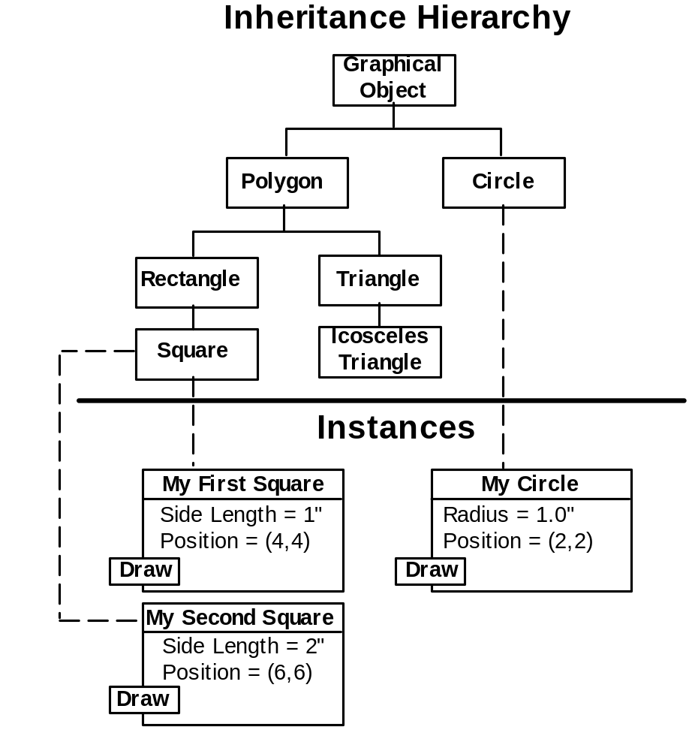
Dynamic Binding of Methods
Dynamic binding is the ability of the run-time system to determine dynamically which version of an operation is to be performed, depending on the object being manipulated.
Example:

Slide 34
Dynamic Binding Implementation
Class instances are typically dynamically allocated in the heap as Class Instance Records.
Class Instance Record (CIR) - The structure of a class instance record is static. A template can be created at compile time. Subclasses extend the template of the parent class by adding new attributes and methods.
Access to attributes is like access to elements of a record - (base address + offset).
Methods that are dynamically bound must have entries in the CIR.
The entry can be a pointer to the code that is set at object instantiation.
The pointer to the object’s methods allows the object to respond to a message by invoking the appropriate code.
Drawback - more indirection.

Slide 35
Dynamic Binding of Methods
All instances of a given class or subclass have the same methods, so the executable parts need be loaded only once.
Virtual function table - (vtable) The Class Instance Record contains a table that holds locations of the methods that might be invoked by an object. Method calls are offsets in the vtable
Example:
class Shape {
virtual double area() const {return 0.0};
virtual double volume() const {return 0.0};
virtual void printShapeName() const = 0;
virtual void print() const = 0;
}
class Point: public Shape {
Point(int = 0, int = 0);
virtual void printShapeName() const
{cout <<“Point: “;}
public void print() const;
private:
int x, y;
}
class Circle: public Point {
Circle(double r = 0.0,int = 0, int = 0);
virtual void printShapeName() const
{cout <<“Circle: “;}
public void print() const;
private:
double radius;
}

Slide 36
Dynamic Binding of Methods
Shape
vtable
arrayOfShapes[]
[0]
[1]
[2]
&point
&circle
&cylinder
0.0
a
0.0
v
0
psn
0
pr
Point point
Point
vtable
x = 7
a
y = 11
v
“Point”
psn
Circle circle
[x,y]
pr
Circle
vtable
x = 22
πr²
a
y = 8
radius = 3.5
baseClassPtr
v
“Circle”
psn
[x,y] r
pr
Cylinder
vtable
Cylinder cylinder
2πr² + 2πrh
a
x = 10
πr²h
v
y = 8
“Cylinder”
psn
radius = 3.3
[x,y] r h
pr
height = 10.0

Slide 37
Dynamic Binding of Methods
With dynamic binding and polymorphism, The following code could be used to print out the shape names in the list:
Shape * baseClassPtr;
for(int i = 0; i < totalShapes; i++) {
baseClassPtr = &arrayOfShapes[i];
baseClassPtr->printShapeName();
}
As this code executes, the following steps occur:
  The ith entry of the arrayOfShapes array is selected. (for example, when i = 1, baseClassPtr points to the Class Instance Record of circle).
  Dereferencing baseClassPtr accesses the circle instance
  Dereference circle’s vtable pointer to access the circle vtable
  Offset 8 bytes to access the printShapeName function pointer
  Dereference the printShapeName function Pointer to get to the code for the circle’s printShapeName function.

Slide 38
Polymorphism Summary
Polymorphism has clear advantages and drawbacks.
Virtual functions and dynamic binding eliminate the need to test for an object’s type (for instance with a switch statement) by implementing polymorphism.
Dynamic binding and polymorphism introduce additional indirection into the process of executing code.
References may be either statically or dynamically bound, depending on how the reference has been established.
In C++, the Standard Template Library (STL) is implemented without the use of virtual functions and polymorphism.

Slide 39
Classes and Abstraction
Classes simplify having several concrete (actual) representations for one abstract data type.
Example:
  Class ArrayStack
  Class LinkedStack
Objects of either class can respond to messages:
  push
  pop
  empty
  full
Information Hiding - the implementation details are hidden in the class
Manifest Interface - interface to an object is its protocol - the set of messages to which it responds.

Slide 40
Objects and Message Passing
Objects
  In “pure object-oriented languages, everything is an object
  Objects have characteristics of both data and programs
  The set of messages to which an object responds is its protocol.
Dynamic vs Static typing
  Static - at compile time (Pascal, Ada, C, C++, Java)
  Dynamic - at run time (not necessarily weak typing) Smalltalk and Lisp
  Security Principle - an object won’t respond to messages not in its protocol
  Interpreted languages allow source code to be available at runtime
  Errors can be fixed during execution of the program

Slide 41
Object Orientation
Smalltalk introduced a new programming paradigm
  Programming is simulation of the “real world”
  Objects have properties and behaviors
  Objects can be classified by similar properties
  Addresses “behaviors of objects in time”
Object oriented approaches are finding wide-spread uses:
  Graphical interfaces
  Object oriented databases
  A silver bullet?

Slide 42
Examples of Abstracted Features in Java
Threads
Lightweight processes in Java
Implement Runnable interface or extend Thread
Requires defining or overriding run() method
High-Level Synchronization Primitives
Lock (interface)
Condition
Previous synchronization mechanism: synchronized methods
H:\jcHDrive\ProgrammingLanguages\Synchronization\
High-Level Client-Server Primitives
Socket – endpoint for communication between two machines
ServerSocket
  waits for requests
  performs some operation
  possibly returns a result to the requester
H:\jcHDrive\ProgrammingLanguages\ClientServer\

Slide 43
Some Comparisons of Object-Oriented Languages

Slide 44
Interoperability
Language Interoperability:
The level and ease of integration with other languages.
  The .NET Framework – Visual Studio.NET is a collection of software development tools with a Common Language Infrastructure all used through the Windows interface. There are 5 .NET languages:
    C#
    Visual BASIC.NET
    JScript
    J#
    Managed C++
  Common Type System – a common class library for these languages
  IR – all compile to the same intermediate representation
Platform Interoperability:
Generally this has meant OS interoperability, but over the last few years the internet browser has emerged as a platform in itself.
Standards Interoperability:
These are all the standards like database systems, graphics libraries, internet protocols, and object communication standards like COM and CORBA, that the language can access.

